Slide 1
On discourse processing
Many slides borrowed from Jurafsky, Jain, …

Slide 2
Outline
Why discourse processing 为什么要进行语篇处理
Rethorical structure theory 语篇理论介绍
Discourse segmentation 语篇分割
Coreference resolution 共指消解引论
Tense processing 时态处理引论

Slide 3
Discourse – challenge for NLP
Most NLP systems use sentence (or utterance) as the basic processing unit: e.g. word segmentation, parsing, machine translation, etc.
However, discourse is the unit for communicating

Slide 4
Discourse – unit for communicating
The meaning of a sentence is determined by context:
  A girl appeared in the window of a building. The man took out a telescope. The man saw the girl with the telescope.
  A girl with a telescope on her neck was walking behind a boy. They were walking toward a man. The boy ran away. The man saw the girl with the telescope.

Slide 5
Examples from translation
Hold up!
坚持！ (hang on)
Hold up!
停住! (stop)
Hold up!
等一下! (wait a moment)
Hold up!
慢点! (slow down)
hold up!
举手! (raise your hand)

Slide 6
Stages in NLP
Sound
waves
Phonetics
Words
Syntactic processing
Parses
Semantic processing
Meaning
Discourse processing
Meaning
in context
This is a conceptual pipeline, humans or computers may process multiple stages simultaneously

Slide 7
Two pieces of language
Case 1
  This is Willie Worm. The tea is hot. Just send 12 Guinness ‘cool token’bottle tops. Applied linguistics is therefore not the same as linguistics.
  4 correct sentences but collectively do not make sense
  Non-discourse
Case 2
  I went shopping this weekend but the mall was too crowded and I didn’t find a parking spot so I returned home disappointed.
  One complete sentence which makes sense
  Discourse

Slide 8
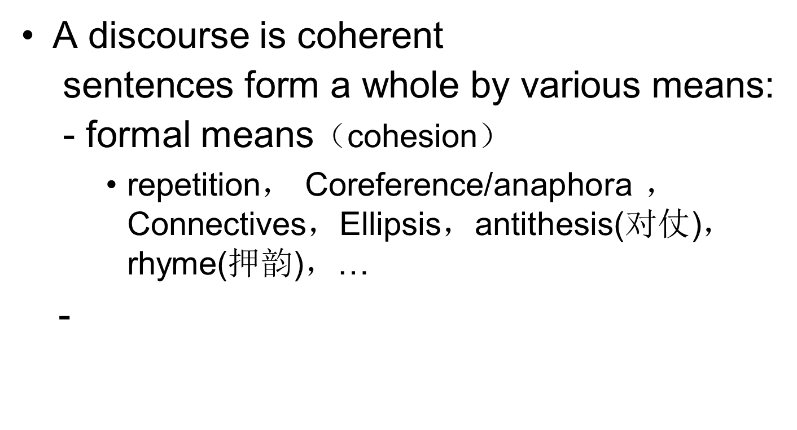
Discourse understanding：Cohesion & coherence

Slide 9
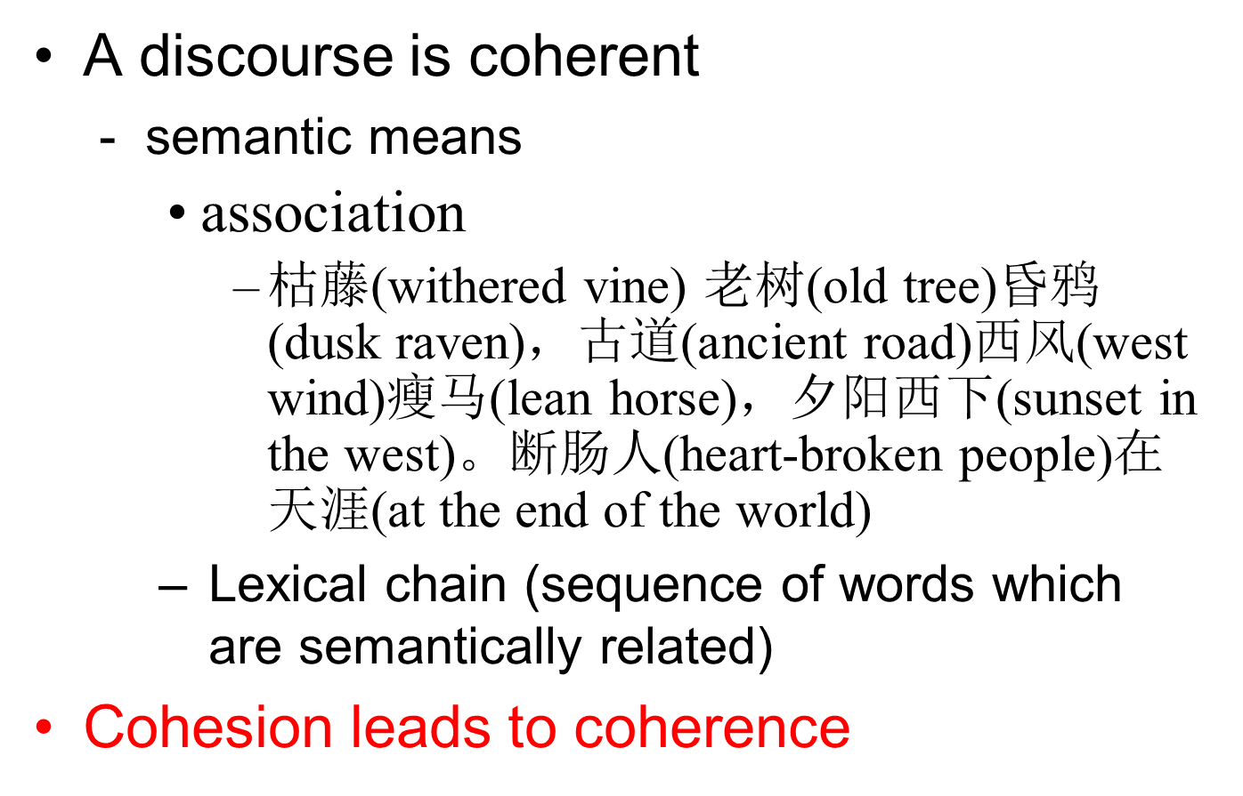
Discourse understanding：Cohesion & coherence

Slide 10
Discourse understanding: structure and function
Discourse is structured
  Tonal change for speech 语调的抑扬顿挫，…
  Opening, developing, changing and concluding for writing an essay 章法的起承转合，…
  scientific articles are segmented into Abstract, Introduction, Methods, Results, Conclusions
Discourse is for comminication语篇是有交际功能的
  Intention
  Interpretation
  Inference

Slide 11
Types of discourse 语篇类型
Three classes of discourse 三种语篇
  Text
  Speech
  Conversation
    Monologue (单口相声)
    Dialogue

Slide 12
discourse processing topics
Discourse relations and structure 语篇结构和语篇关系
Special structure of Chinese discourse 汉语语篇的特殊结构
Tense computation 时态计算
Speech acts 言语行为
…

Slide 13
discourse processing topics
Information Retrieval 信息检索
Information Extraction 信息抽取
Entity linking
Summarization 文摘
Discourse segmentation for text, audio, video) 语篇分割，语音分割，视频分割
Machine translation 机器翻译
Dialog system 对话系统
Composition correction 作文批改
…

Slide 14
Discourse theory 语篇理论
Rethorical Structure Theory
  slides are from Taboada and Manfred Stede (slight modification)
Discourse Representation Theory
Discourse Lexicalized TAG

Slide 15
Rhetorical Structure Theory
Created as part of a project on Natural Language Generation at the Information Sciences Institute (www.isi.edu)
Central publication
  Mann, William C. and Sandra A. Thompson. (1988). Rhetorical Structure Theory: Toward a functional theory of text organization. Text, 8 (3), 243-281.
Recent overview
  Taboada, Maite and William C. Mann. (2006). Rhetorical Structure Theory: Looking back and moving ahead. Discourse Studies, 8 (3), 423-459.
For many more publications and applications, visit the bibliography on the RST web site
  http://www.sfu.ca/rst/
  http://www.sfu.ca/rst/05bibliographies/

Slide 16
Principles
Coherent texts consist of minimal units, which are linked to each other, recursively, through rhetorical relations
  Rhetorical relations also known, in other theories, as coherence or discourse relations
  These units are hierarchically organized to form a whole
Coherent texts do not show gaps or non-sequiturs
  Therefore, there must be some relation holding among the different parts of the text

Slide 17
Components
Units of discourse
  Texts can be segmented into minimal units, or spans
Nuclearity
  Some spans are more central to the text’s purpose (nuclei), whereas others are secondary (satellites)
  Based on hypotactic and paratactic relations in language
Relations among spans
  Spans are joined into discourse relations
Hierarchy/recursion
  Spans that are in a discourse relation may enter into new relations in a bigger context
elementary discourse unit is a better term

Slide 18
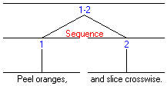
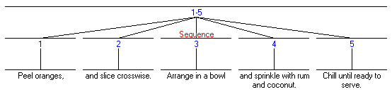
Paratactic (coordinate)
At the sub-sentential level (traditional coordinated clauses)
  Peel oranges, and slice crosswise.
But also across sentences
  1. Peel oranges, 2. and slice crosswise. 3. Arrange in a bowl 4. and sprinkle with rum and coconut. 5. Chill until ready to serve.

Slide 19
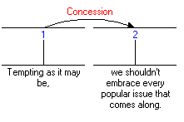
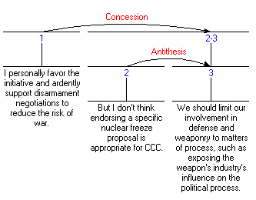
Hypotactic (subordinate)
Sub-sentential Concession relation
Concession across sentences
  Nucleus (spans 2-3) made up of two spans in an Antithesis relation

Slide 20
Relations
They hold between two non-overlapping text spans
Most of the relations hold between a nucleus and a satellite, although there are also multi-nuclear relations
A relation consists of:
  1. Constraints on the Nucleus,
  2. Constraints on the Satellite,
  3. Constraints on the combination of Nucleus and Satellite,
  4. The Effect.

Slide 21
Example: Evidence
Constraints on the Nucleus
  The reader may not believe N to a degree satisfactory to the writer
Constraints on the Satellite
  The reader believes S or will find it credible
Constraints on the combination of N+S
  The reader’s comprehending S increases their belief of N
Effect (the intention of the writer)
  The reader’s belief of N is increased
Assuming a written text and readers and writers;
Definitions of most common relations are available from the RST web site (www.sfu.ca/rst)

Slide 22
Relation types
Relations are of different types
  Subject matter: they relate the content of the text spans
    Cause, Purpose, Condition, Summary
  Presentational: more rhetorical in nature. They are meant to achieve some effect on the reader
    Motivation, Antithesis, Background, Evidence

Slide 23
Other possible classifications
Relations that hold outside the text
  Condition, Cause, Result
vs. those that are only internal to the text
  Summary, Elaboration
Relations frequently marked by a discourse marker
  Concession (although, however); Condition (if, in case)
vs. relations that are rarely, or never, marked
  Background, Restatement, Interpretation
Preferred order of spans: nucleus before satellite
  Elaboration – usually first the nucleus (material being elaborated on) and then satellite (extra information)
vs. satellite-nucleus
  Concession – usually the satellite (the although-type clause or span) before the nucleus

Slide 24
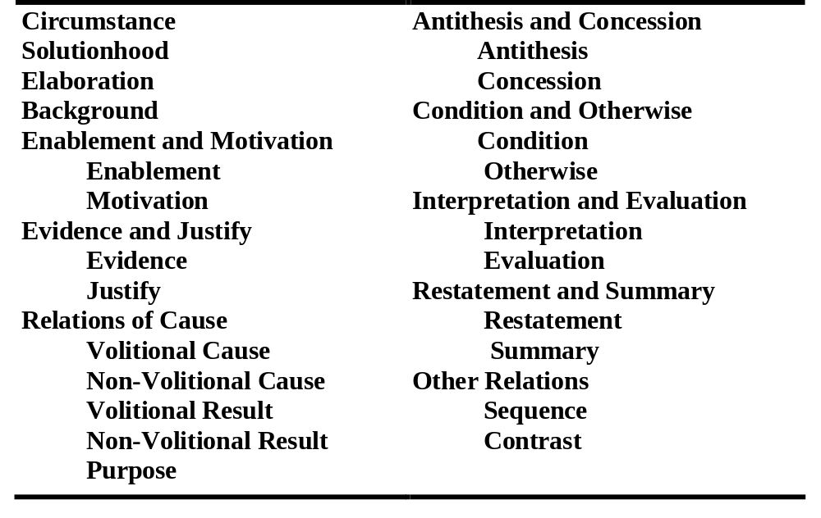
Relation names (in M&T 1988)
Other classifications are possible, and longer and shorter lists have been proposed

Slide 25
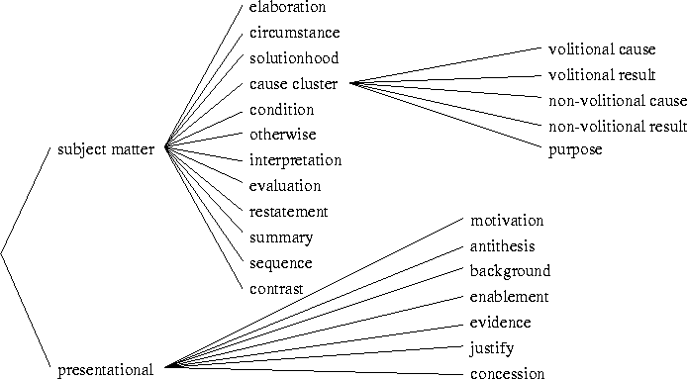
RST relations
www.hcrc.ed.ac.uk/ilex/ilex3/Levels/Levels/node7.html

Slide 26
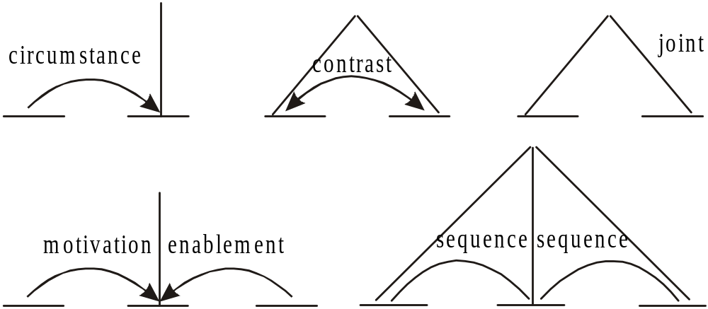
Schemas
They specify how spans of text can co-occur, determining possible RST text structures

Slide 27
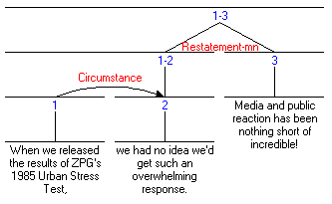
Graphical representation
A horizontal line covers a span of text (possibly made up of further spans
A vertical line signals the nucleus or nuclei
A curve represents a relation, and the direction of the arrow, the direction of satellite towards nucleus

Slide 28
How to do an RST analysis
Divide the text into units
  Unit size may vary, depending on the goals of the analysis
  Typically, units are clauses (but not complement clauses)
Examine each unit, and its neighbours. Is there a clear relation holding between them?
If yes, then mark that relation (e.g., Condition)
If not, the unit might be at the boundary of a higher-level relation. Look at relations holding between larger units (spans)
Continue until all the units in the text are accounted for
Remember, marking a relation involves satisfying all 4 fields (especially the Effect). The Effect is the plausible intention that the text creator had.

Slide 29
Some issues
Problems in identifying relations
  Judgments are plausibility judgments. Two analysts might differ in their analyses
Definitions of units
  Vary from researcher to researcher, depending on the level of granularity needed
Relations inventory
  Many available
  Each researcher tends to create their own, but large ones tend to be unmanageable
A theory purely of intentions
  In contrast with Grosz and Sidner’s (1986), it does not relate structure of discourse to attentional state. On the other hand, it provides a much richer set of relations.

Slide 30
Applications
Writing research
  How are coherent texts created
  RST as a training tool to write effective texts
Natural Language Generation
  Input: communicative goals and semantic representation
  Output: text
Rhetorical/discourse parsing
  Rendering of a text in terms of rhetorical relations
  Using signals, mostly discourse markers
Corpus analysis
  Annotation of text with discourse relations (Carlson et al. 2002)
  Application to spoken language (Taboada 2004, and references in Taboada and Mann 2006)
Relationship to other discourse phenomena
  Between nuclei and co-reference
For more applications (up to 2005 or so):
  Taboada, Maite and William C. Mann. (2006). Applications of Rhetorical Structure Theory. Discourse Studies, 8 (4), 567-588.

Slide 31
Resources
RST web page
  www.sfu.ca/rst
RST tool (for drawing diagrams)
  http://www.wagsoft.com/RSTTool/

Slide 32
Selected references (see RST web site for full bibliographies)
Carlson, Lynn, Daniel Marcu and Mary Ellen Okurowski. (2002). RST Discourse Treebank, LDC2002T07 [Corpus]. Philadelphia, PA: Linguistic Data Consortium.
Grosz, Barbara J. and Candace L. Sidner. (1986). Attention, intentions, and the structure of discourse. Computational Linguistics, 12 (3), 175-204.
Mann, William C. and Sandra A. Thompson. (1988). Rhetorical Structure Theory: Toward a functional theory of text organization. Text, 8 (3), 243-281.
Taboada, Maite. (2004). Building Coherence and Cohesion: Task-Oriented Dialogue in English and Spanish. Amsterdam and Philadelphia: John Benjamins.
Taboada, Maite and William C. Mann. (2006a). Applications of Rhetorical Structure Theory. Discourse Studies, 8 (4), 567-588.
Taboada, Maite and William C. Mann. (2006b). Rhetorical Structure Theory: Looking back and moving ahead. Discourse Studies, 8 (3), 423-459.

Slide 33
Penn Discourse Treebank
Recently released (2008) corpus that is likely to lead to better systems for discourse processing
Has rhetorical/coherence relations encoded associated with the discourse connectives
Linked to the Penn Treebank
http://www.seas.upenn.edu/~pdtb/

Slide 34
Chinese Discourse Treebank
Soochow University has build a Chinese discourse treebank
No direct link available, but their NLP lab has an English website: http://nlp.suda.edu.cn/

Slide 35
implicit discourse relations recognition
Problem description:
  He left. She came.
  What’s the relationship between these two sentences?
  He left because she came.
  After he left, she came.
  …

Slide 36
Our work on implicit discourse relations recognition
Changxing Wu, *Xiaodong Shi, Yidong Chen, Jinsong Su, Boli Wang. Improving Implicit Discourse Relation Recognition with Discourse-specific Word Embeddings. Proceedings of the 55th Annual Meeting of the Association for Computational Linguistics，2017, Vol. 2, 269–274.
Wu, Changxing, *Xiaodong Shi, Yidong Chen, Yanzhou Huang, and Jinsong Su. Leveraging bilingually-constrained synthetic data via multi-task neural networks for implicit discourse relation recognition. Neurocomputing 243(2017):69-79. (SCI: 20171203465559)
Changxing Wu, *Xiaodong Shi, Yidong Chen and Yanzhou Huang，Bilingually-constrained Synthetic Data for Implicit Discourse Relation Recognition, EMNLP 2016, Nov 1-5, Austin.
Changxing WU, *Xiaodong SHI, Yanzhou HUANG, Recursive Autoencoder Based Automatic Features Learning for Implicit Discourse Relations Recognition. Journal of Computational Information Systems, 11:12 (2015) 4263–4271

Slide 37
Discourse Segmentation
Discourse Segmentation: Separating a document into a linear sequence of subtopics
  For example: scientific articles are segmented into Abstract, Introduction, Methods, Results, Conclusions
  This is often a simplification of a higher level structure of a discourse
Applications of automatic discourse segmentation:
  For Summarization: Summarize each segment separately
  For Information Retrieval or Information Extraction: Apply to an appropriate segment
Related task: Paragraph segmentation, for example of a speech transcript

Slide 38
Unsupervised Discourse Segmentation
Given raw text, segment it into multiple paragraph subtopics
Cohesion-based approach: Segment into subtopics in which sentences/paragraphs are cohesive with each other

Slide 39
Cohesion
Cohesion: Links between text units due to linguistic devices
Lexical Cohesion: Use of same or similar words to link text units
  Today was Jack's birthday. Penny and Janet went to the store. They were going to get presents. Janet decided to get a kite. "Don't do that," said Penny. "Jack has a kite. He will make you take it back.”
Non-lexical Cohesion: For example, using anaphora

Slide 40
Cohesion-based Unsupervised Discourse Segmentation
TextTiling algorithm (Hearst, 1997)
  compare adjacent blocks of text
  look for shifts in vocabulary
Do pre-processing: Tokenization, remove stop words, stemming
Divide text into pseudo-sentences of equal length (say 20 words)

Slide 41
Cohesion-based Unsupervised Discourse Segmentation
TextTiling algorithm (Hearst, 1997)
  compare adjacent blocks of text
  look for shifts in vocabulary
Do pre-processing: Tokenization, remove stop words, stemming
Divide text into pseudo-sentences of equal length (say 20 words)

Slide 42
TextTiling Algorithm contd.
Compute lexical cohesion score at each gap between pseudo-sentences
Lexical cohesion score: Similarity of words before and after the gap (take say 10 pseudo-sentences before and 10 pseudo-sentences after)
Similarity: Cosine similarity between the word vectors (high if words co-occur)
Gap

Slide 43
TextTiling Algorithm contd.
Compute lexical cohesion score at each gap between pseudo-sentences
Lexical cohesion score: Similarity of words before and after the gap (take say 10 pseudo-sentences before and 10 pseudo-sentences after)
Similarity: Cosine similarity between the word vectors (high if words co-occur)
Similarity
Gap

Slide 44
TextTiling Algorithm contd.
Plot the similarity and compute the depth scores of the “similarity valleys”, (a-b)+(c-b)
Assign segmentation if the depth score is larger than a threshold (e.g. one standard deviation deeper than mean valley depth)
valley
c
a
b

Slide 45
TextTiling Algorithm contd.
Plot the similarity and compute the depth scores of the “similarity valleys”, (a-b)+(c-b)
Assign segmentation if the depth score is larger than a threshold (e.g. one standard deviation deeper than mean valley depth)

Slide 46
Supervised Discourse Segmentation
Easy to get supervised data for some segmentation tasks
  For e.g., paragraph segmentation
  Useful to find paragraphs in speech recognition output
Model as a classification task: Classify if the sentence boundary is a paragraph boundary
  Use any classifier: SVM, Naïve Bayes, Maximum Entropy etc.
Or model as a sequence labeling task: Label a sentence boundary with “paragraph boundary” or “not a paragraph boundary label”

Slide 47
Supervised Discourse Segmentation
Features:
  Use cohesion features: word overlap, word cosine similarity, anaphoras etc.
  Additional features: Discourse markers or cue word
Discourse marker or cue phrase/word: A word or phrase that signal discourse structure
  For example, “good evening”, “joining us now” in broadcast news
  “Coming up next” at the end of a segment, “Company Incorporated” at the beginning of a segment etc.
  Either hand-code or automatically determine by feature selection

Slide 48
Our work on discourse segmentation
王博立，*史晓东，一种基于循环神经网络的古文断句方法，NLPCC 2016，2016.12.2-6，昆明。
王博立, 史晓东, 谭知行, 陈毅东, 王伟莉. 一种基于神经网络语言模型的古文断句方法. 汉语词汇语义学研讨会, 2016.5. 新加坡.

Slide 49

Coreference resolution
Reference: the process by which speakers use expressions like “Jane Simon” and “her” to denote a real-world entity
  Referring expression: NL expression used to perform reference
  Referent: the entity that is referred to
  Shorthand: we say “she” refers to Jane. Actually speaker refers to Jane by uttering “she”
Jane Simon, Chief Financial Officer of Prime Corp. since 1986, saw her pay jump 20%, to $1.3 million, as the 37-year-old also became the financial- services company’s president. She was…

Slide 50
Coreference resolution
Coreference: two referring expressions that are used to refer to the same entity are said to corefer
Jane Simon is the antecedent of her.
Reference to an entity that has been previously introduced into the discourse is called anaphora; and the referring expression used is anaphoric
Jane Simon, Chief Financial Officer of Prime Corp. since 1986, saw her pay jump 20%, to $1.3 million, as the 37-year-old also became the financial- services company’s president. She was…

Slide 51
Many types of reference
According to John, Bob bought Sue an Integra, and Sue bought Fred a Legend
  But that turned out to be a lie (a speech act)
  But that was false (proposition)
  That struck me as a funny way to describe the situation (manner of description)
  That caused Sue to become rather poor (event)
  That caused them both to become rather poor (combination of several events)

Slide 52
Types of referring expressions
Indefinite noun phrases: new to hearer
  I saw an Acura Integra today
  Some Acura Integras were being unloaded…
  I am going to the dealership to buy an Acura Integra today. (specific/non-specific)
    I hope they still have it (narrow scope)
    I hope they have a car I like (wide scope)
Definite noun phrases: identifiable to hearer because
  Mentioned: I saw an Acura Integra today. The Integra was white
  Identifiable from beliefs: The Indianapolis 500
  Inherently unique: The fastest car in …

Slide 53
Referring Expressions: Pronouns
I saw an Acura Integra today. It was white
Compared to definite noun phrases, pronouns require more referent salience.
  John went to Bob’s party, and parked next to a beautiful Acura Integra
  He went inside and talked to Bob for more than an hour.
  Bob told him that he recently got engaged.
  ??He also said that he bought it yesterday.
  √ He also said that he bought the Acura yesterday

Slide 54
More on Pronouns
Cataphora: pronoun appears before referent:
  Before he bought it, John checked over the Integra very carefully.

Slide 55
Named Entities
Stanley is out of town today.
IBM just announced a new product line

Slide 56
Coreference NLP tasks
Group together in a text all the referring expressions that have the same denotation
  Pronominal anaphora resolution
  Anaphora resolution between named entities
  Full noun phrase anaphora resolution
Adapted from a slide by Ani Nenkova

Slide 57
Complex relationship between referring expression and antecedent
Not every referring expression refers to something!
  Generics
    In Alaska you have to wear a coat
    I saw no less than 6 Acura Integras today. They are the coolest cars.
  Bridging inferences
  I almost bought an Acura Integra today, but the engine seemed noisy.
  Pleonastic pronouns (冗代词)
  It is raining
  睡他一觉
  Discontinous sets
    Referents may have been evoked in discontinuous phrases
  John has a Volvo and Mary has a Mazda. They drive them all the time

Slide 58
Pronominal Reference Resolution
Given a pronoun, find the reference (either in text or as a entity in the world)
  Hard constraints
    Morphological and syntactic
  Soft constraints
    Thematic, simple semantic

Slide 59
Hard constraints on coreference
Number agreement
  John has an Acura. It is red.
Person and case agreement
  *John and Mary have Acuras. We love them (where We=John and Mary)
Gender agreement
  John has an Acura. He/it/she is attractive.
Syntactic constraints
  John bought himself a new Acura (himself=John)
  John bought him a new Acura (him = not John)

Slide 60
Pronoun Interpretation Preferences
Selectional Restrictions
  John parked his Acura in the garage. He had driven it around for hours.
Recency
  John has an Integra. Bill has a Legend. Mary likes to drive it.

Slide 61
Pronoun Interpretation Preferences
Grammatical Role: Subject preference
  John went to the Acura dealership with Bill. He bought an Integra.
  Bill went to the Acura dealership with John. He bought an Integra
  (?) John and Bill went to the Acura dealership. He bought an Integra

Slide 62
Parallelism Preference
Mary went with Sue to the Acura dealership. Sally went with her to the Mazda dealership.
Mary went with Sue to the Acura dealership. Sally told her not to buy anything.

Slide 63
Repeated Mention preference
Entities that have been focused on in the prior discourse
  Are more likely to continue to be focused
  hence references to them are more likely to be pronominalized.
  John needed a car to get to his new job. He decided that he wanted something sporty. Bill went to the Acura dealership with him. He bought an Integra. [claim: he=John]

Slide 64
Verb Semantics Preferences
John telephoned Bill. He lost the pamphlet on Acuras.
John criticized Bill. He lost the pamphlet on Acuras.
Implicit causality
  Implicit cause of criticizing is object.
  Implicit cause of telephoning is subject.
This’s really hard!!

Slide 65
Traditional knowledge-based approaches to coreference
Lappin and Leass (1994)
  Hand-crafted heuristics
    Syntactic filters
    Morphological filter
    Pleonastic pronoun filter
    Procedure for identifying possible antecedents
    Salience assignment w.r.t grammatical role, proximity, parallelism, etc
  Decision Procedure
Slide adapted from Claire Cardie

Slide 66
Lappin and Leass (1994) algorithm
Given he/she/it, assign antecedent.
Implements only recency and syntactic preferences
Two steps
  Discourse model update
    When a new noun phrase is encountered, add a representation to discourse model with a salience value
    Modify saliences.
  Pronoun resolution
    Choose the most salient antecedent

Slide 67
Main-stream methods for Coreference resolution
Statistical methods: treat coreference resolution as a classification task.
  Choose suitable features 选择合适的特征
Deep learning methods:
  Learning features automatically

Slide 68
NP Coreference task
MUC-6, MUC-7 “Message Understanding Conferences”
Automatic Content Extraction (ACE) Evaluation

Slide 69
Coreference resolution applications 共指消解应用
Information extraction
  Merge information for the same entity
Question answering
  Mapping mentions in the question and the answer.
Machine translation
  Literally translating pronouns can produce funny translation
Text summarization
  Identify salient coreference chains

Slide 70
Introduction to tense processing时态处理介绍
The representation of time 时间的表示
Reichenbach’s tense theory
Tense comparison between languages 时态对比

Slide 71

Representing Time
Events are associated with points or intervals in time.
We can impose an ordering on distinct events using operators such as (>,=,<).
Temporal logic notation:
(∃w,x,t) Arrive(w,x,t)
Constraints on variable t
I arrived in New York
(∃ t) Arrive(I,NewYork,t) (t < Now)

Slide 72
Interval Events
Need t_{start} and t_{end}
She was driving to New York until now
(∃t_{start},t_{end}) Drive(She,NewYork,t_{start,}t_{end})
(t_{start}<Now) (t_{end}=Now)

Slide 73

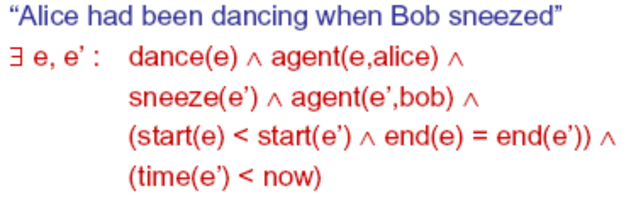
Another representation
Use events and semantic roles and treat time as an attribute of the event 引入事件和语义角色，把时间作为事件的一个属性

Slide 74
Relation Between
Tenses and Time
Relation between simple verb tenses and points in time is not straightforward
Present tense used like future:
  We fly from Baltimore to Boston at 10
Complex tenses:
  Flight 1902 arrived late
  Flight 1902 had arrived late

Slide 75
Reference Point
Reichenbach (1947) introduced notion of Reference point (R), separated out from Speech time (S) and Event time (E)
Example:
  When Mary's flight departed, I ate lunch
  When Mary's flight departed, I had eaten lunch
Departure event specifies reference point.

Slide 76
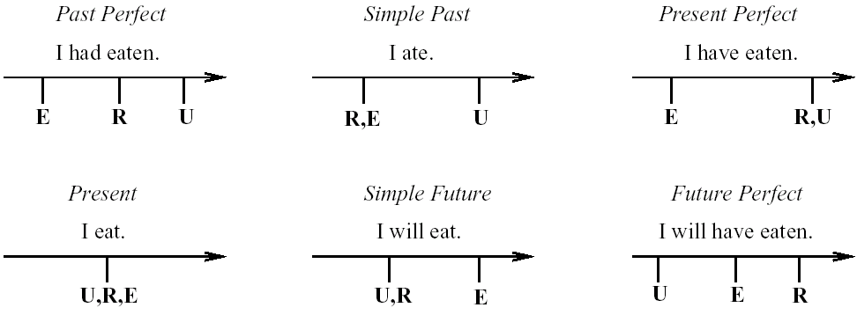
Reichenbach Applied to Tenses
S
S
R,S
S,R,E
S,R
S
We refer to the S,R,E notation as a Basic Tense Structure (BTS)

Slide 77
Tense comparison between languages
Tense comparison is a necessary step for discourse-based machine translation between English and Chinese 研究英汉两种语言的时间表示的计算模型是机器翻译的需要，目前还没有较好的理论
  Tense and aspect
  Tense translation

Slide 78
tense and aspect 时态和时体
Tense represents the relation between the time of the event and the narrator, while aspect represents the state of the event 时态表示事件的时间和说话者的关系，而时体表示事件的发生状况
There are tense and aspect in English, while there is only aspect in Chinese英语有时态和时体，汉语只有时体没有时态

Slide 79
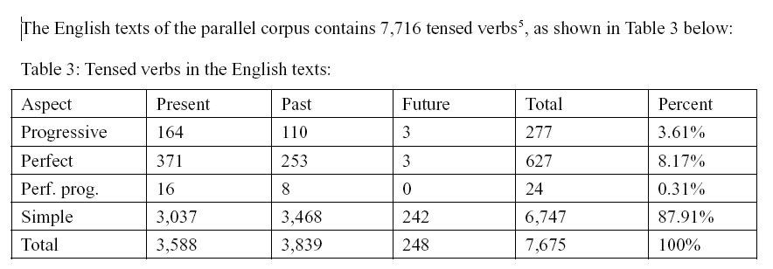
Tense and aspect in English (3*4)
Xiao, R. Z., and A. M. McEnery. "A corpus-based approach to tense and aspect in English-Chinese translation." The 1st International Symposium on Contrastive and Translation Studies between Chinese and English. 2002.

Slide 80
Tense and aspect in Chinese
汉语的时间和时体
Chinese represents time by adverbs 汉语的时间通过副词（昨天、已经、刚）表示
Chinese represents aspect by particles and verb repetition 语的时体通过助词（着、了、过）、趋向词（起来、下去）、重叠（摸摸、合计合计）

Slide 81
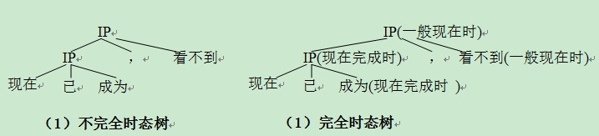
Tense Tagging and translation
Our work on Tense processing in MT
  Tense tagging based on tense trees
  Chen, Yijiang, et al. "Cross-Lingual Tense Tagging Based on Markov Tree Tagging Model." NLPCC 2015. Springer.

Slide 82
Tense Tagging and translation
Our work on Tense processing in MT
  Background time recognition
  Implemented in Rule-based MT (Neon CE)
    昨天我买了一本书。书很贵。后来被同学拿走了。
    秋天凉了。树叶黄了。一片片叶子从树上落下来。天空那么蓝，那么高。一群大雁往南飞，一会儿排成个人字，一会儿排成个一字。啊！秋天到了。

Slide 83
Our work on other aspects of discourse processing
We also implemented number agreement and reference processing by using 2-pass decoding in the Neon CE system

Slide 84
Projects 课程设计
Try to design an algorithm to segment ancient Chinese texts into sentences. 对古汉语文本用“，。”进行句子分割（明句读）

Slide 85
Projects 课程设计
Build a tense translation model for English-Chinese machine Translation. 建立英汉的时态翻译模型，即研究在英汉翻译中如何将英语的时态翻译成汉语合适的时间表示，在汉英翻译中如何用英语的时态和时体来合适地表示汉语中隐含的时间。你的算法适用于何种机器翻译模型（统计模型还是规则模型）？

Slide 86
Projects 课程设计
Read papers about Prof. Songrou’s Generalized Topic Grammar (广义话题语法) model, and study the problem of translating omitted Chinese words in Chinese-English machine translation.

